Slide 1
Colet Bartow, Senior Manager, Teaching and Learning Dept.
Jess Bryant, Teacher Learning Hub Coordinator
Carli Cockrell, Professional Learning Coordinator
Professional Development Planning to Upskill Online Teaching
Department of Teaching and Learning
Curriculum, Instruction, and Professional Learning Unit

Slide 2
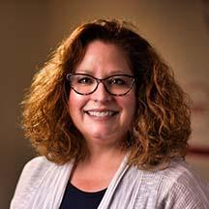
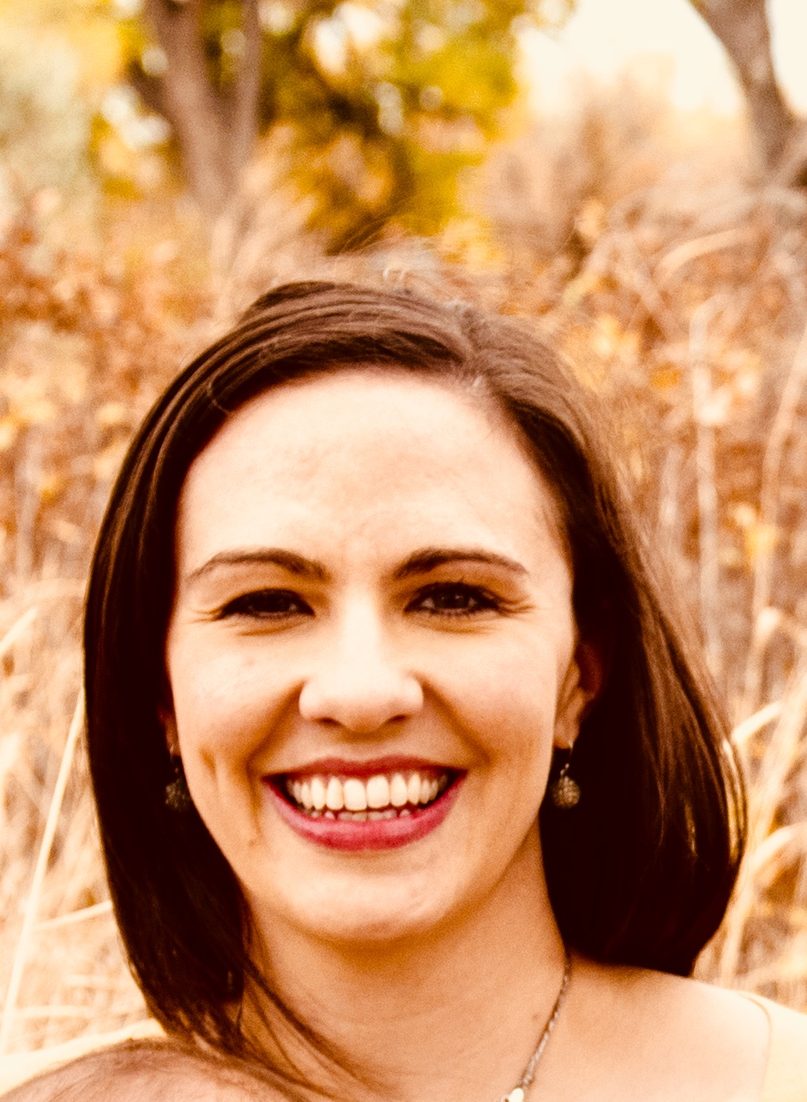
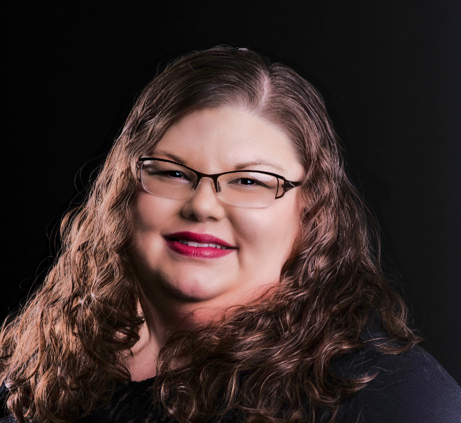
A Little About Us
Colet Bartow
Jess Bryant
Carli Cockrell

Slide 3
Agenda
Planning
Ongoing Evaluation
Areas of Consideration
Identifying skill-set gaps and making a professional development plan.
Evaluating and planning as part of a continual cycle of improvement.
Using the identified skill-set gaps and what is already available to upskill online teaching.
1
2
3

Slide 4
Planning - Step 1: Pick a Platform
Easier for...
students and teacher to learn
tech team to support
parents to support their kids
you to provide PD
Consistent platform and select tools

Slide 5
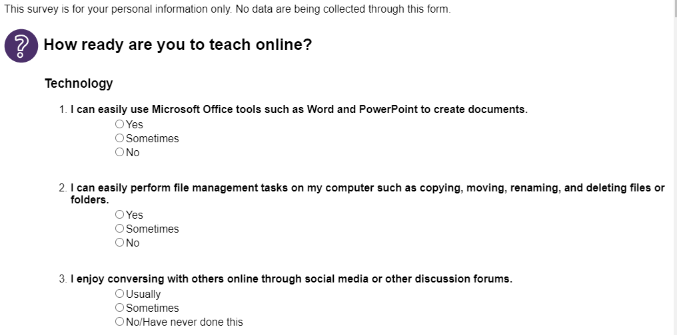
Planning - Step 2: Establish Skill-Set Gaps
Online Teaching Readiness Survey Example from Indiana University
Assess for identified skills
What are the gaps?
Time is valuable
Prioritize
Group similar to in the classroom

Slide 6
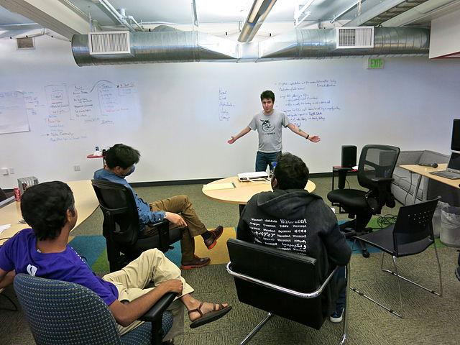
Planning - Step 3: Make a PD Plan
Choose Professional Learning Models
Peer-coaching groups/mentorships
Formal instruction
In-the-moment tutorials and knowledgebases

Slide 7
Planning - Step 4: Ongoing Evaluation
Plan ahead for routine check-ins
Is this working?
What supports are needed?
How is morale?

Slide 8
Professional Development - Areas of Need
Platform Training
Effective Online Pedagogy
How to support special education, ELs, and specific student populations
How are you going to teach students and parents to use the platform?

Slide 9
Effective Online Pedagogy
Focus on how this transition can help in the long-term!
Not a priority in traditional K-12 pre-service education
Not tool dependent
Focused on theories, principles, and student-focused instructional design and competencies (NSQOL)

Slide 10
Available PD List
Visit https://bit.ly/PDUpskill
Handout is available on the SAM Virtual Administrators Institute website!

Slide 11
Closing Thoughts
More time upfront = payoff throughout the year
Sell it to your staff (reuseable!)
Check in on your teachers
It won’t be perfect - that’s ok
Clear communication
PD autonomy

Slide 12
Questions?
Colet Bartow, cbartow@mt.gov
Jessica Bryant, jbryant3@mt.gov
Carli Cockrell, carli.cockrell@mt.gov

