Slide 1



      #RedefiningReady

Slide 2
Ready or Not:
Broadening the Definition
of Student Success

Slide 3
Readiness Gap
30%
46%
70%
Met
ACT
benchmarks
Attained
a degree
Enrolled in
college
ACT (2017). The Condition of College and Career Readiness.
National Bureau of Labor Statistics (2016). TED: The Economics Daily; National Center for Education Statistics (2016). IES Fast Facts

Slide 4


Slide 5



Slide 6
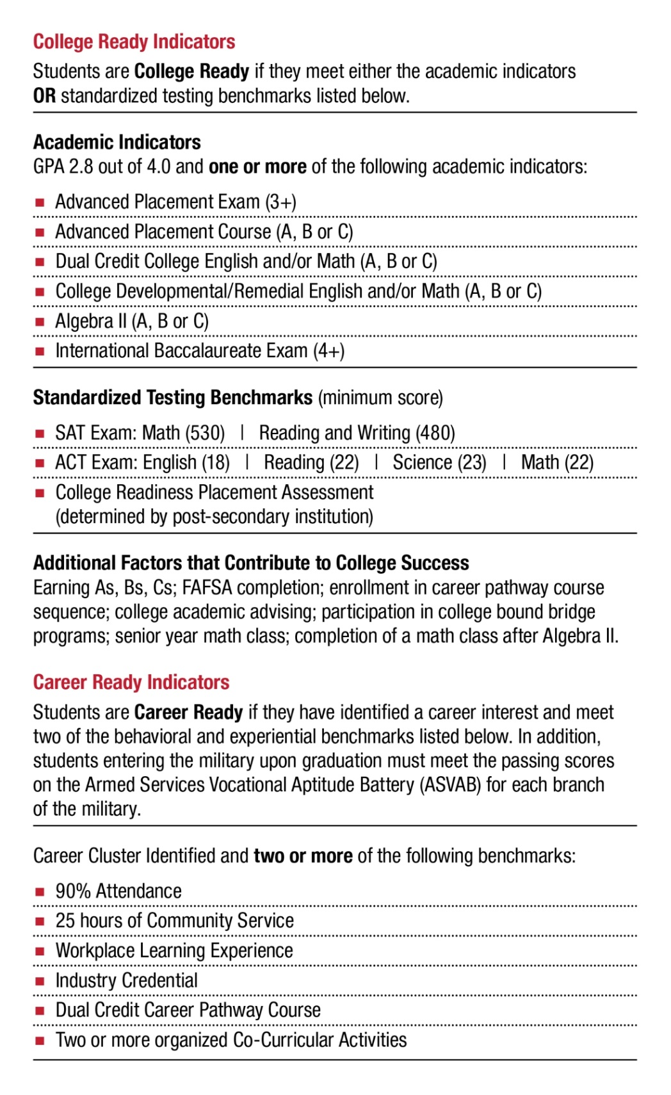
Redefining Ready!
College Ready and Career Ready Indicators

Slide 7
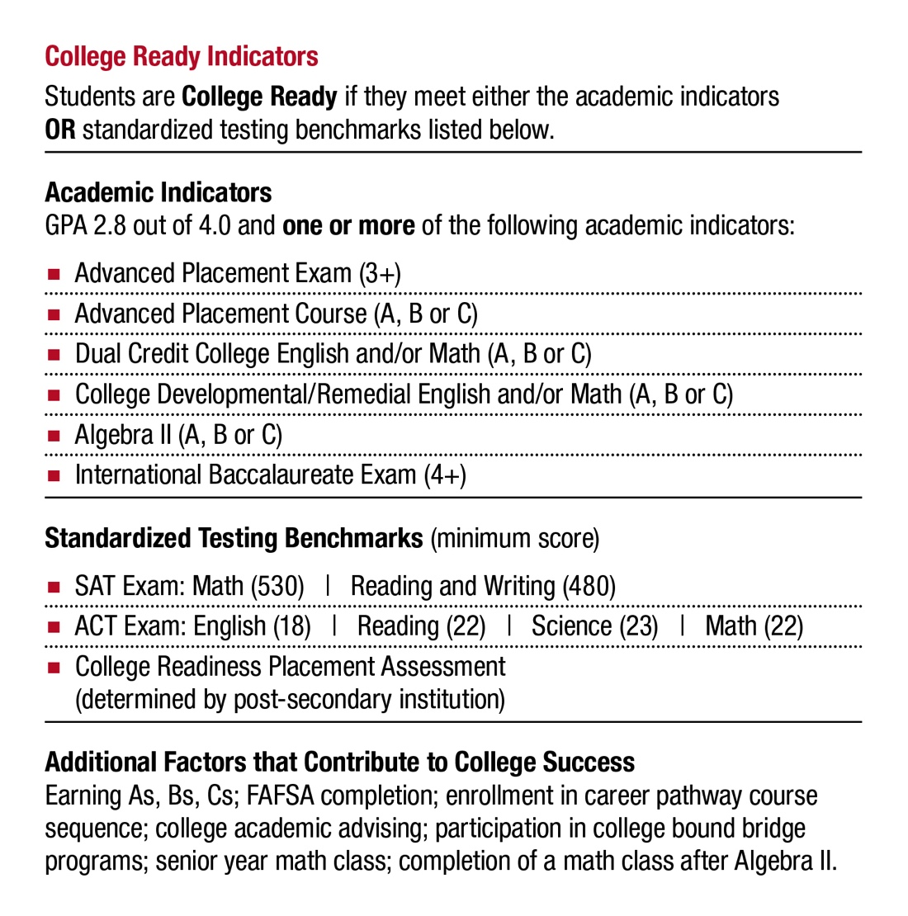
Redefining Ready!
College Ready Indicators

Slide 8
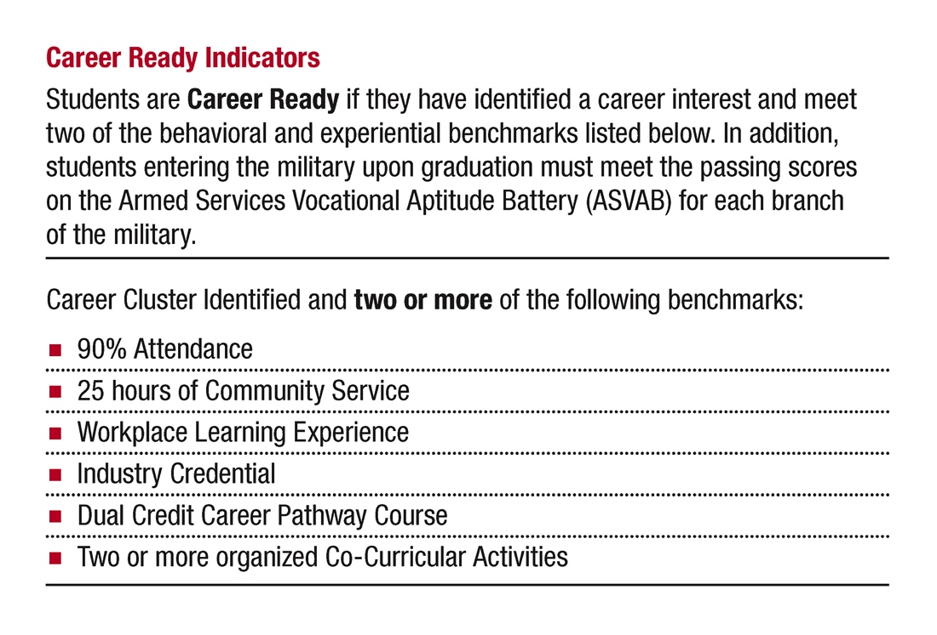
Redefining Ready!
Career Ready Indicators

Slide 9

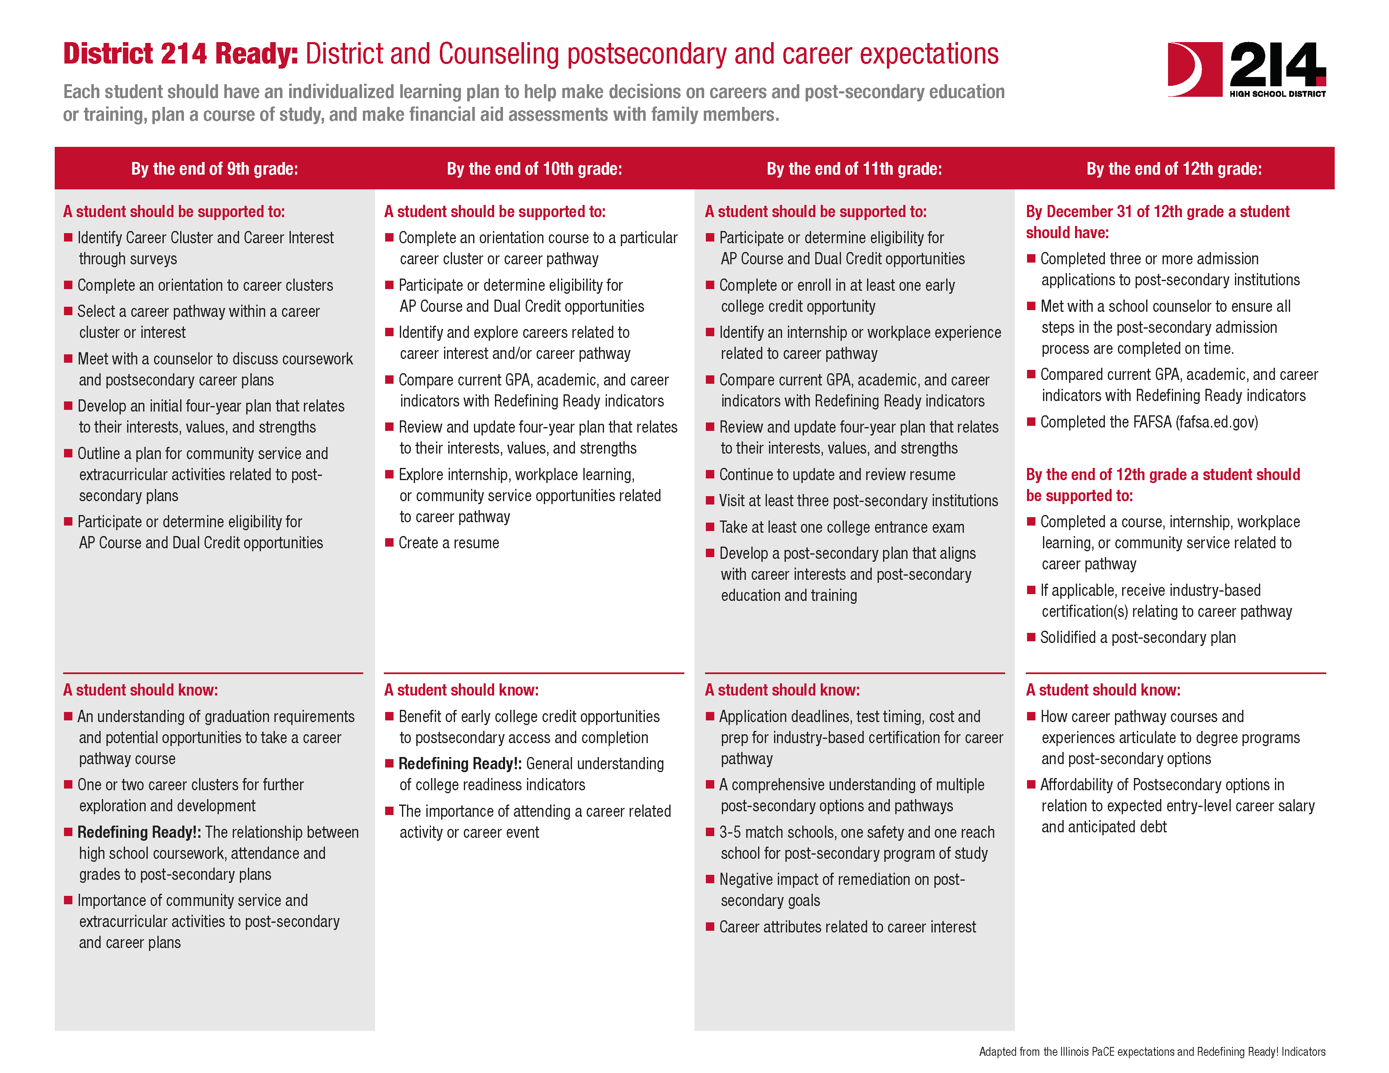
District 214 Ready:
District and Counseling postsecondary and career expectations

Slide 10
English Readiness Skills for
Incoming Freshmen
The following list is a guide to assist in prioritizing the foundations necessary
for success in our introductory English course, Written and Oral Communication.
Writing
All students are able to do the following:
Read Summarize author’s purpose for a reading.
Use various types and styles of writing – i.e., persuasive, expository, comparison/contrast, and narrative.
Make a clear central thesis/claim that guides the organization of the essay.
Cite clear and specific textual evidence that supports the central claim.
Write a well-structured essay that contains an introduction, body paragraphs, and conclusion.
Employ appropriate transitions.
Use conventions of standard written English.
Proofread writing for errors.
Grammar
All students are able to do the following:
Identify and understand the functions of the different Parts of Speech.
Form conventional and complete sentences that avoid comma splices and fragments.
Maintain subject-verb and pronoun-antecedent agreement.
Communicate clearly in writing (basic sentence construction, punctuation, usage, and capitalization).
Determine when particular contexts call for singular or plural possessive nouns and for plural
or possessive nouns.

Slide 11
English Readiness Skills for
Incoming Freshmen
The following list is a guide to assist in prioritizing the foundations necessary
for success in our introductory English course, Written and Oral Communication.
Reading (both fiction and non-fiction)
All students are able to do the following:
Read closely in a moderately challenging text to identify explicitly stated information, ideas,
or literary elements.
Determine the best textual evidence for a simple conclusion.
Identify the central idea of a passage with a single, clear purpose.
Identify a simple relationship between information, ideas, or people (e.g., recognizing a basic
comparison, contrast, or sequence).
Determine the meaning of a relatively common word or phrase using clear context clues.
Recognize a straightforward similarity or difference in a pair of moderately challenging passages.
Annotate for a purpose (i.e., author’s purpose, ask questions, vocabulary, etc.).
Speaking and Listening
All students are able to do the following:
Adapt speech to a variety of contexts and tasks, demonstrating command of formal English when indicated or appropriate.
Engage effectively in a range of collaborative discussions.
Use information to support their own views while acknowledging new information expressed by others.
Integrate multiple sources of information and present in diverse media or formats.

Slide 12
Algebra and Geometry Readiness Indicators
for Incoming Freshmen
Students enter District 214 with differing experiences in math. To better help our middle school partners determine proper placement for their students, the following categories of mathematics can be used to assist in prioritizing the foundations necessary for success in a child’s first high school math course.
Middle school instructors will be provided with a detailed list of statements that provide added detail for instruction.
Number and Operations
Students can understand types of numbers (integers, fractions, decimals), their properties and
the correct order of operations. Students can perform computations correctly, with and without
a calculator.
Algebra and Functions
Students can solve problems using algebraic expressions and symbols to represent relationships, patterns and functions of different types.
Data, Statistics, and Probability
Students can analyze data, understand descriptive statistics, make inferences, and determine
the likelihood that certain events will occur.
Geometry and Measurement
Students can solve problems based on understanding the properties of shapes, such as triangles
and circles, and the spatial relationships between angles and lines.

Slide 13
Algebra and Geometry Readiness Indicators
for Incoming Freshmen
Students enter District 214 with differing experiences in math. To better help our middle school partners determine proper placement for their students, the following categories of mathematics can be used to assist in prioritizing the foundations necessary for success in a child’s first high school math course.
Middle school instructors will be provided with a detailed list of statements that provide added detail for instruction.
Representations
Students can communicate ideas and solve problems using verbal, numerical, symbolic
and graphical representations.
Problem Solving
Students can solve abstract and practical problems using a variety of strategies.
Students can monitor their problem-solving progress and evaluate the validity of answers
in context.
Reasoning
Students can develop and use mathematical arguments and proofs to explore the truth
of conjectures and justify conclusions.
Communications
Students can express mathematical ideas precisely.
Students can communicate ideas coherently and clearly in the language and notation
of mathematics.

Slide 14
https://www.youcubed.org/
Jo Boaler – Math Mindsets

Slide 15
New and Upcoming AASA National Initiatives
RR! Elementary and Middle School Readiness Indicators
SEL Cohort
Rural Literacy Grant Partnership with Waterford Learning
Legislative Advocacy
Legal Support
National Conference on Education
Leadership Network

Slide 16
      www.RedefiningReady.org
      #RedefiningReady

Slide 17

Dr. David R. Schuler
Superintendent, High School District 214
david.schuler@d214.org
twitter: DSchuler1970
Notes:
JEN

